Slide 1
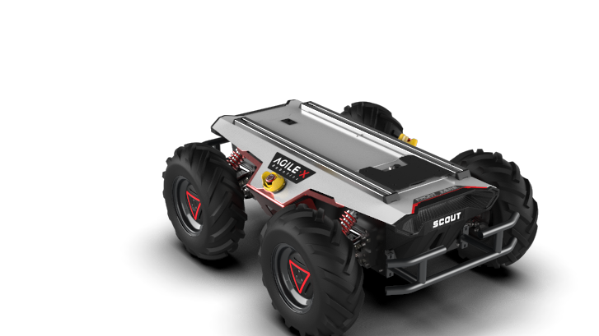

Perception, localization and mapping for mobile robots First project
Marco Cella 10578855
Giacomo Delcaro 10560602
Alessandro Colombo 10573335

Slide 2
FILES 1/3
cfg
parameters.cfg: file for the dynamic reconfigure
launch
scout_launch.launch: launches the velpubsub, odompubsub and residual nodes. It is also possible to change the inital position of the robot
scout_launch_rviz.launch: just like the other one but it also runs rviz with the right configuration
msg
OdomInt.msg: contains the custom message to publish odometry and integration method
er_array.msg: custom message to publish the residuals between the ground truth and the estimated odometry

Slide 3
FILES 2/3
srv
resetOdom.srv: empty, it does not need any input from the user since it simply resets the pose
setOdom.srv: defines the types of the requested input from the user to set the pose to x, y, theta
src
velpubsub.cpp: the node that subscribes to the rpm topics and publishes a twist message containing all of the robot’s seeds
odompubsub.cpp: the node that subscribes to the topic advertised by velpubsub and publishes the complete odometry and the custom message
residuals.cpp: the node publishes the pose errors between /scout_odom and our computed odometry /our_odom and also the pose errors between /gt_pose (in odom reference frame) and /our_odom

Slide 4
FILES 3/3
config
plot_layout.xml: layout for plotjuggler
rototranslation.m: MATLAB file to compute the “odom” to “world” rototranslation parameters
scout_rviz.rviz: rviz configuration to visualize the computed odometry vs the ground truth

Slide 5
PARAMETERS & TF tree
PARAMETERS
x_init: initial x position in the odom frame
y_init: initial y position in the odom frame
theta_init: initial yaw angle wrt the odom frame
CHI: ratio between apparent and real base_line
Inv_RATIO: 1/ratio of the gearbox
TF TREE
odom
base_link
world (static_transform)

Slide 6
Custom messages
Odometry custom message
OdomInt.msg:
nav_msgs/Odometry odo
std_msgs/String int_method
Message used to compute the position errors and the error cost function
er_array.msg:
std_msgs/Float64 dx
std_msgs/Float64 dy
std_msgs/Float64 dtheta
std_msgs/Float64 cumulateError

Slide 7
How to run everything 1/2
catkin_make in the catkin workspace root
source catkin_ws/devel/setup.bash
roslaunch project1 scout_launch.launch
rosbag play -l bag1.bag
NB: for the step 4 you must cd to the folder where your bag files are.
It is now possible to echo the data from the different topics.
If you want to visualize the movement on rviz:
Launch roslaunch project1 scout_launch_rviz.launch
Play the bag

Slide 8
How to run everything 2/2
DYNAMIC RECONFIGURE
While the nodes are running, type in the bash:
rosrun dynamic_reconfigure dynparam set /odompubsub intmethod value
"Value" can be either 0 for euler integration or 1 for runge – kutta
SERVICES
Reset service: rosservice call /reset_odom
Set service: rosservice call /set_odom x y theta
NB: theta is in [deg] !

Slide 9
Apparent baseline and transmission ratio
In order to find the parameters to match /scout_odom, we compared the estimated velocities values with the ground truth ones. For the transmission ratio we've used the values of the longitudinal velocity vx, whereas for the apparent baseline we've used the angular velocity wz.
The best values we've found are the following:
Transmission ratio: 1:38.7
Apparent baseline: 1.75 * B
To have a quantitative assessment on how we were improving when changing the parameters, we used PlotJuggler and the Residuals node mentioned above.
In particular we used 4 different types of errors:
dx, dy, dtheta: longitudinal, lateral and angular difference between our computed pose and /scout_odom or /gt_pose
cumulateError: this is a filtered sum of the errors, which means that it is the average of the last 100 quadratic errors. Each quadratic error is the square root of the sum of the square of dx, dy, dtheta (each multiplied by a particular quadratic weight).

Slide 10
Apparent baseline and transmission ratio
For the errors with respect to /scout_odom we chose the weights so as to give the same importance to a longitudinal or lateral error of 1 cm and an angular error of 60 degrees.
For the errors with respect to /gt_pose, 1 cm and 120 degrees (since the orientation measurement was not smooth and had an offset problem mentioned below).
To find the parameters to match /gt_pose we also had to find the rototranslation from world to odom and find an orientation offset of /gt_pose with respect to its trajectory (see below).
Since we did not have any velocities, we used the following heuristic function: we started from the previous values and decreased the transmission ratio to match /gt_pose movement sequence, and then we decreased the apparent baseline so that the curves had a smaller radius (greater curvature).
We obtained the following results:
- Transmission ratio: 1:40.0
- Apparent baseline: 1.64 * B

Slide 11
“odom” to “world” rototranslation
To compute this rototranslation we copied 2 messages with rostopic echo from /scout_odom and /gt_pose.
/gt_pose is not accurate in the first seconds, so we waited for some seconds (about 16s) and as soon as we saw a coherent /gt_pose we copied its pose and the corresponding /scout_odom pose.
We assumed that at the beginning /scout_odom is correct, so we can use its pose as reference to find the rototranslation from "odom" (frame_id of /scout_odom) to "world" (frame id of /gt_pose). This has been computed in MATLAB (in the script rototranslation.m).
Doing so we noticed that there was an inconsistency between the /gt_pose theta orientation and the direction of motion of /gt_pose, as if the orientation vector were not indicating the motion direction (so it was not tangent to the trajectory). As a matter of fact, the orientation was very accurate but the trajectory seemed to have a different rotation.
We made the hypothesis that the orientation field in /gt_pose could have an offset wrt the motion of the robot.

Slide 12
“odom” to “world” rototranslation
Therefore, we tuned CHI, Inv_RATIO, the rotation of the trajectory (so the rotation from "world" to "odom") and the constant offset of the orientation of /gt_pose.
We noticed that this offset was very consistent (in the first 60 seconds of simulation it is almost constant) and was about 13.5 degrees.
Therefore, we fixed the reference system accordingly (and we removed this offset in the residuals node when computing the difference between /gt_pose orientation and our computed orientation).
In the end the “world” reference frame turned out to have a yaw rotation of about 67 deg with respect to “odom” frame, and /gt_pose has an orientation offset of about 13.5 degrees with respect to its trajectory.

Slide 13
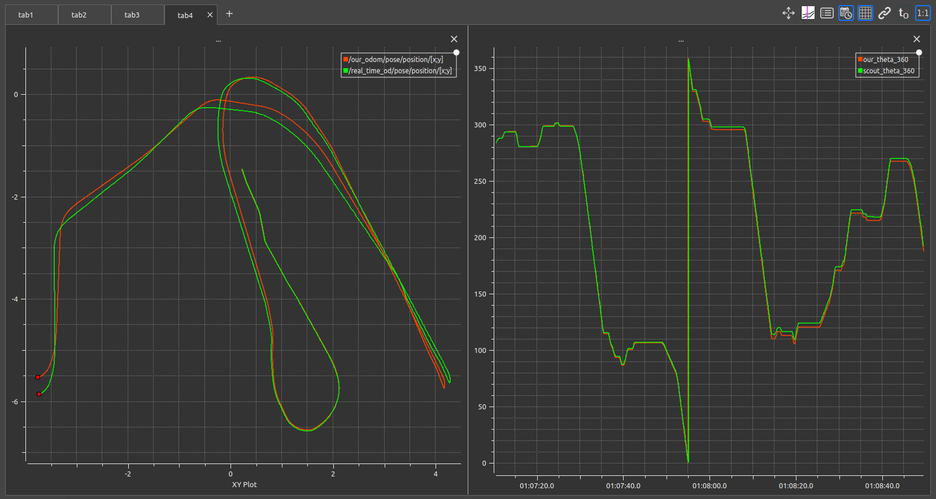
Experiment 1 - /scout_odom
We will now show some pictures of the results we got from PlotJuggler.
The first picture shows on the left the XY trajectory (in meters) of the computed odometry versus the odometry taken from /scout_odom with NON optimized parameters. On the right the orientation of the robot is shown (in degrees).
START
CHI: 1.76, RATIO: 1:38.3, Simulation time: 1’30’’

Slide 14
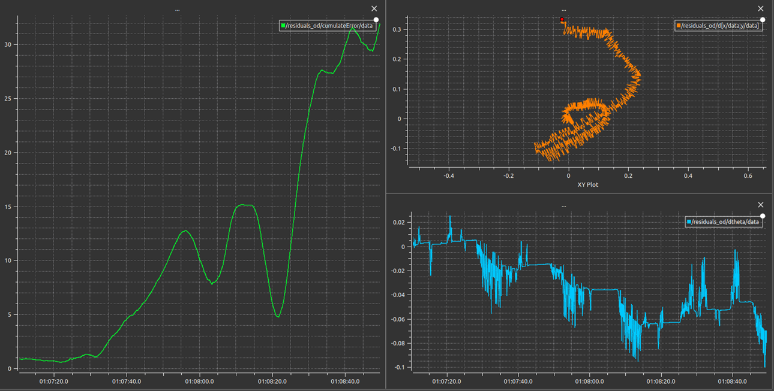
EXPERIMENT 1 - /scout_odom
Now we can analyze the errors with respect to /scout_odom.
In particular on the left the cumulateError is shown, while on the top right there is the XY error plot [m] of dx and dy. On the bottom right dtheta [rad] over time is shown.
CHI: 1.76, RATIO: 1:38.3
Simulation time: 1’30’’
CHI: 1.76, RATIO: 1:38.3, Simulation time: 1’30’’

Slide 15
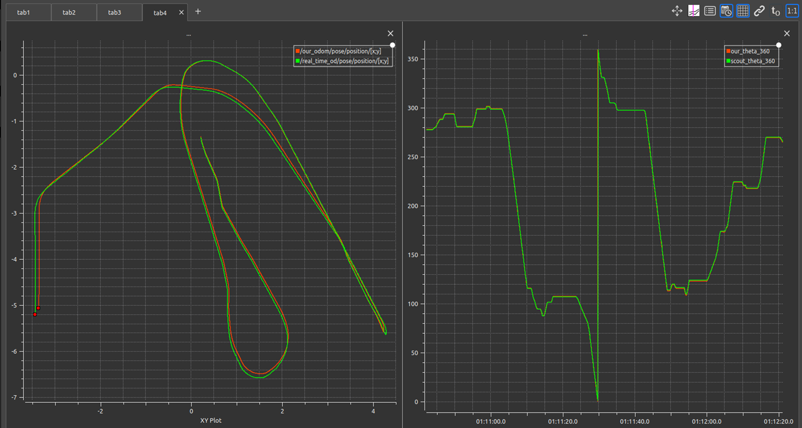
Experiment 2 - /scout_odom
After optimizing the parameters we managed to get a better result. The tracking is very accurate.
our computed odometry
/scout_odom
START
CHI: 1.75, RATIO: 1:38.7, Simulation time: 1’30’’

Slide 16
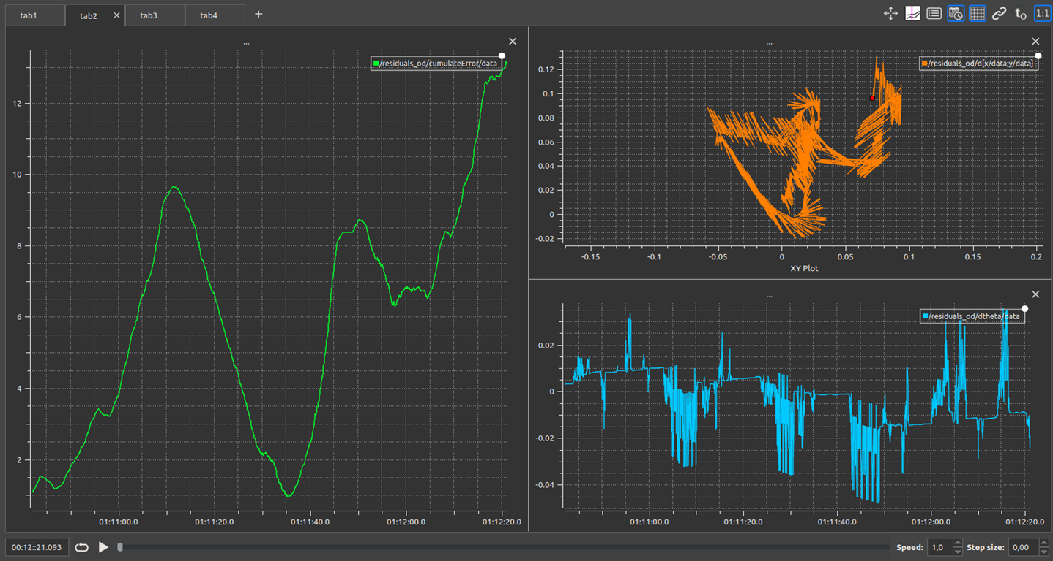
Experiment 2 - /scout_odom
With the optimized parameters the cost function decreased a lot (the maximum value decreases from about 33 to about 13). Also the XY error plot shows that we are much closer to /scout_odom.
CHI: 1.75, RATIO: 1:38.7, Simulation time: 1’30’’

Slide 17
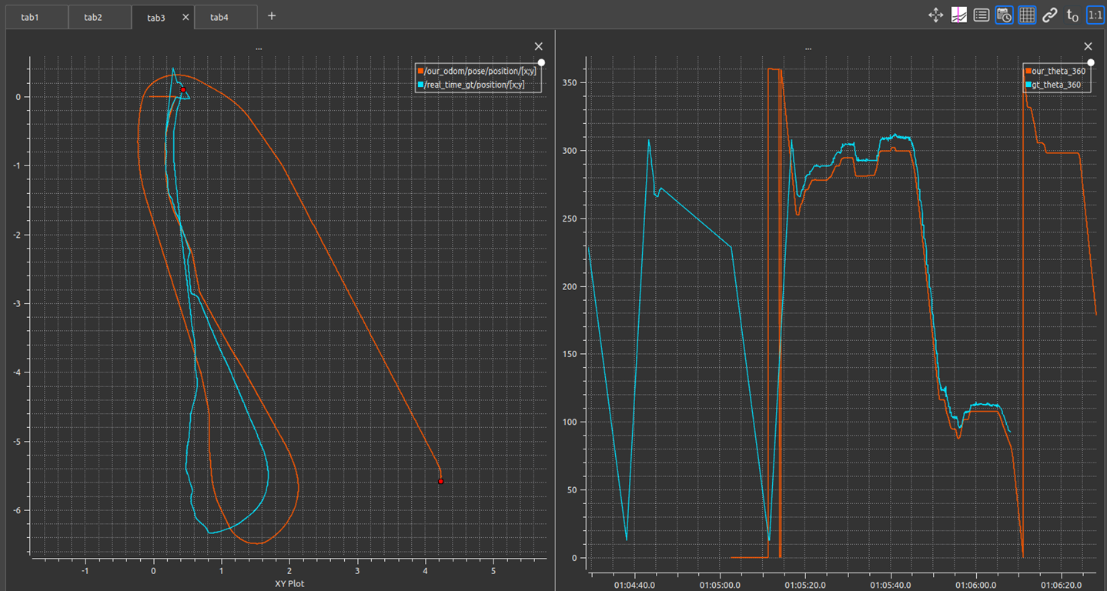
Experiment 3 - /gt_pose
We tried to compare our computed odometry with the optimized parameters to /gt_pose (in “odom” reference frame).
The results were not good.
The simulation could only last 40 seconds due to /gt_pose unavailability.
Notice that there is an almost constant offset in the theta plot (on the right), which is the orientation offset mentioned above.
START
INITIAL /gt_pose INSTABILITY
HERE /gt_pose IS NOT AVAILABLE
CONSTANT OFFSET
CHI: 1.75, RATIO: 1:38.7, Simulation time: 40’’

Slide 18
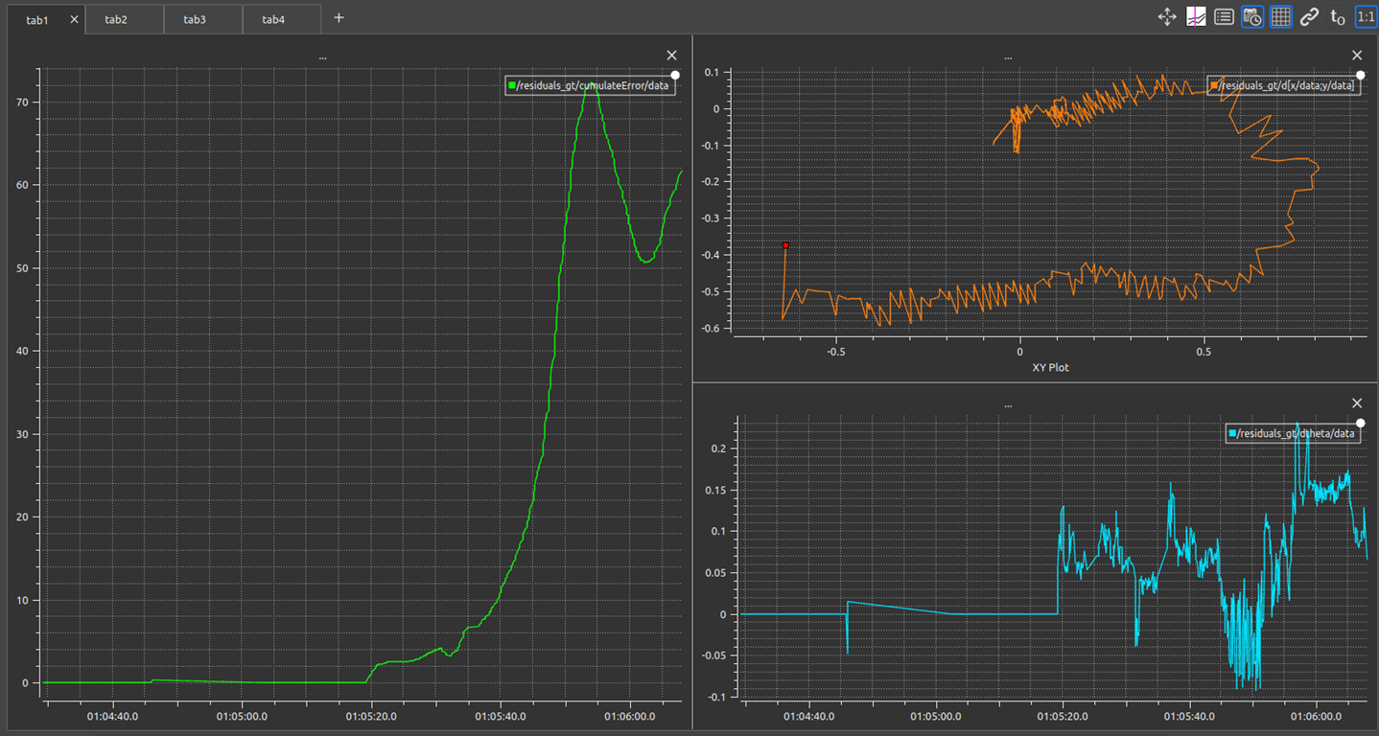
Experiment 3 - /gt_pose
This is the cost function we would like to improve with a better parameter tuning.
CHI: 1.75, RATIO: 1:38.7, Simulation time: 40’’

Slide 19
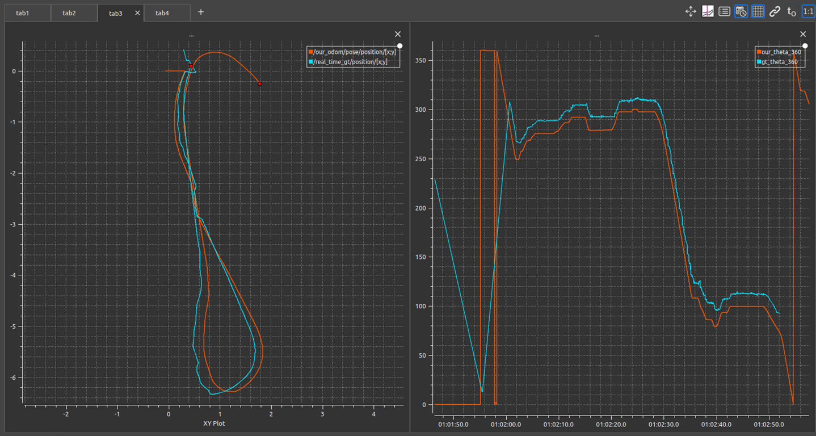
Experiment 4 - /gt_pose
START
After optimizing the parameters we managed to get a better result.
our computed odometry
/gt_pose
CONSTANT OFFSET
CHI: 1.64, RATIO: 1:40.0, Simulation time: 40’’

Slide 20
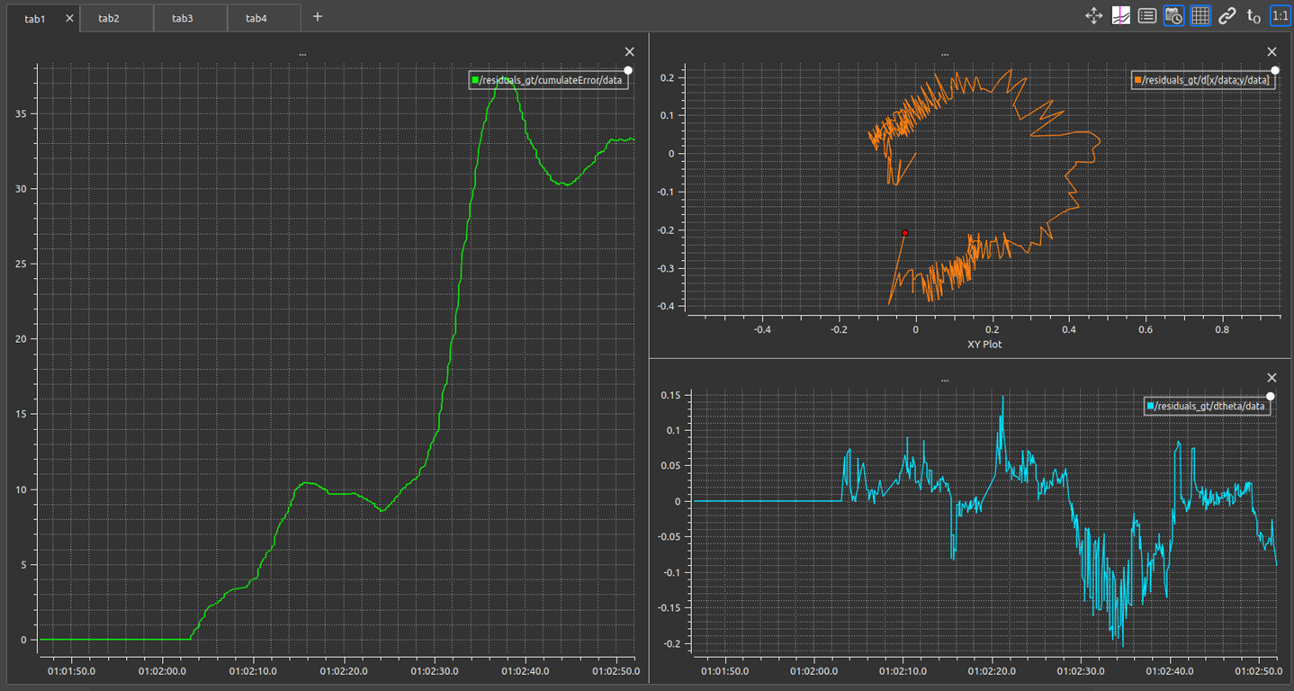
Experiment 4 - /gt_pose
With the optimized parameters the cost function decreased a lot (the maximum value decreases from about 75 to about 38). Also the XY and the theta error plot shows that we are much closer to /scout_odom.
CHI: 1.64, RATIO: 1:40.0, Simulation time: 40’’

Slide 21
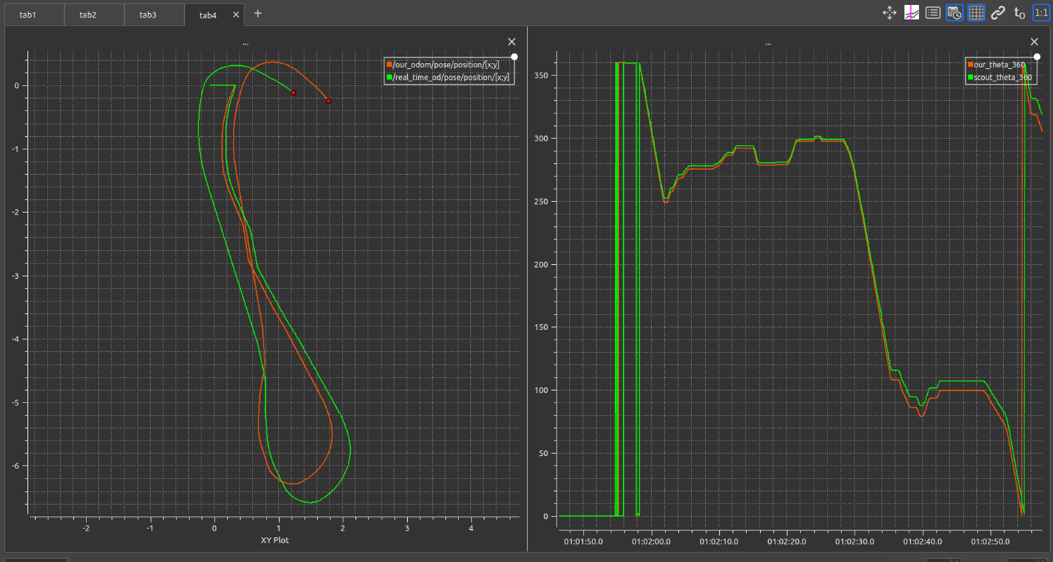
Experiment 5 - /scout_odom
Here is a comparison with /scout_odom with the optimal parameter for /gt_pose.
our computed odometry
/scout_odom
The result is acceptable but worse than the one optimized for /scout_odom.
START
CHI: 1.64, RATIO: 1:40.0, Simulation time: 40’’

Slide 22
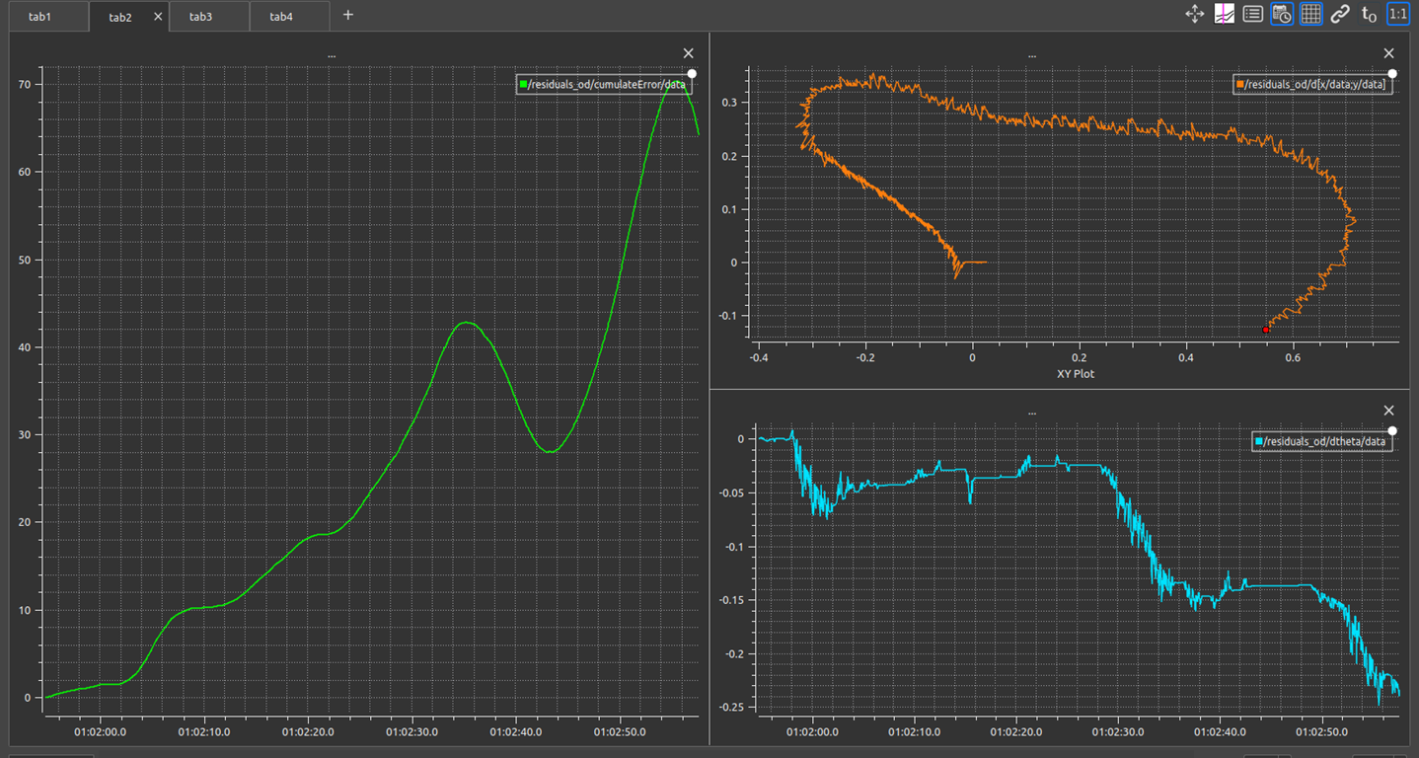
Experiment 5 - /scout_odom
This is the cost function for the last experiment, it can be noticed that the cost is much higher than the optimal one (which had a maximum value of about 13).
CHI: 1.75, RATIO: 1:38.7, Simulation time: 40’’

Slide 23
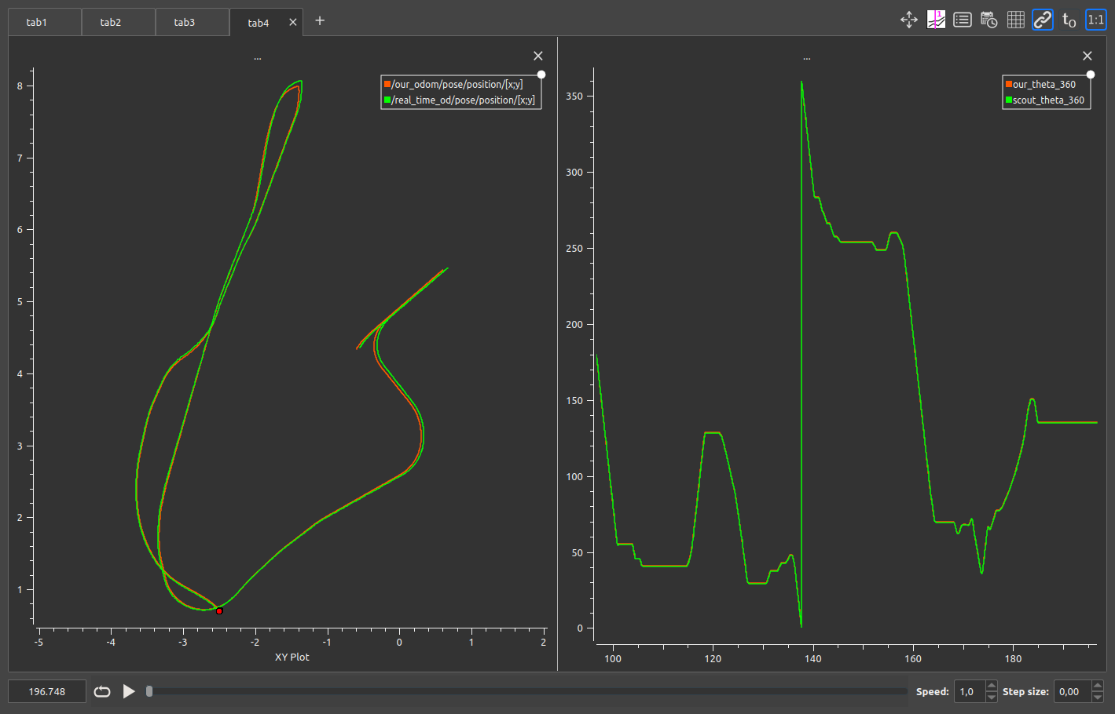
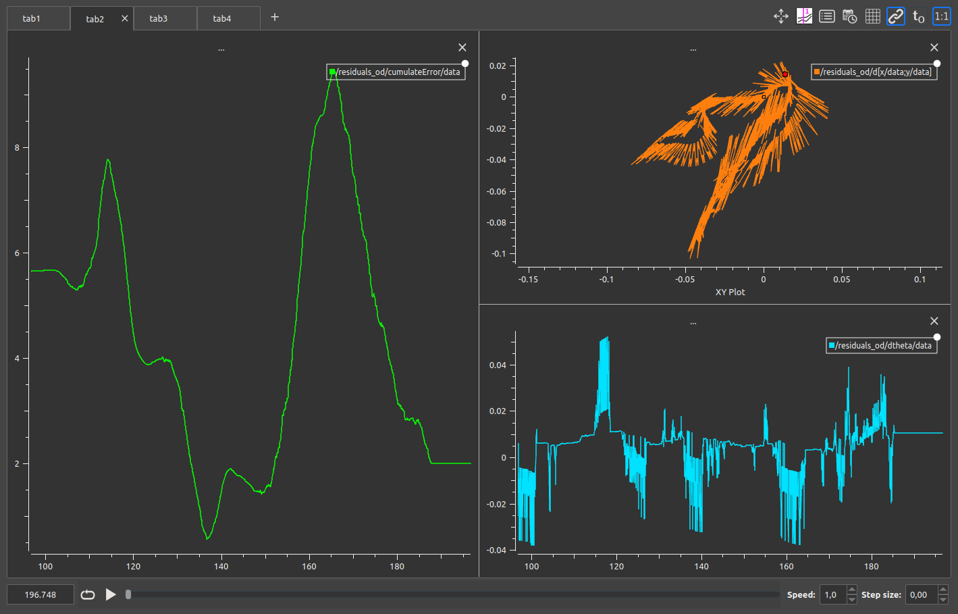
VALIDATION 1 – bag2
This is the trajectory and orientation of the second bag (the parameters are the ones optimized for /scout_odom)
our computed odometry
/scout_odom
CHI: 1.75, RATIO: 1:38.7
Cost function

Slide 24
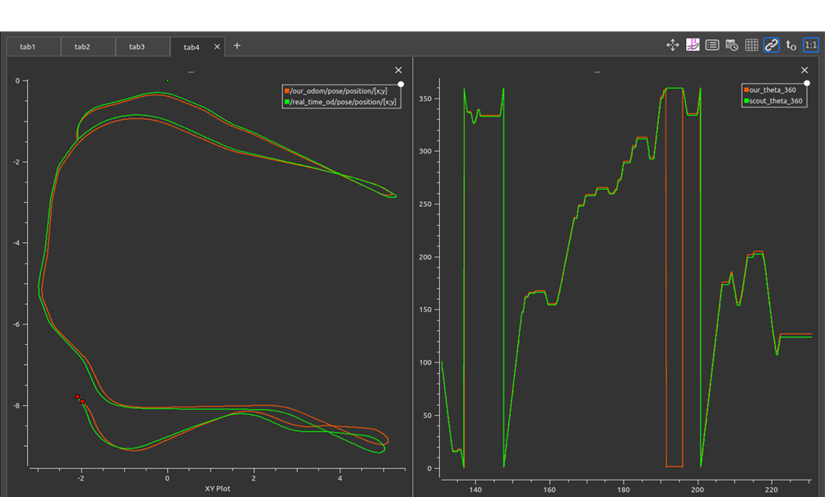
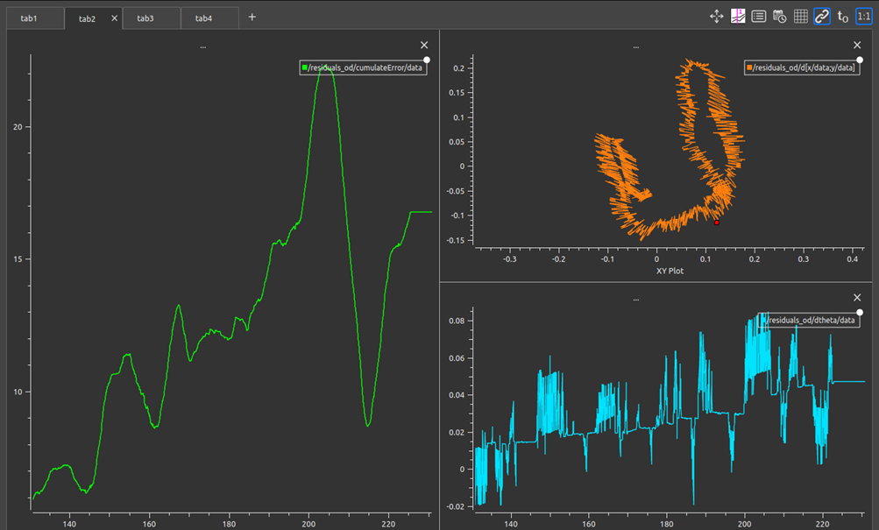
VALIDATION 2 – bag3
This is the trajectory and orientation of the second bag (the parameters are the ones optimized for /scout_odom)
our computed odometry
/scout_odom
CHI: 1.75, RATIO: 1:38.7
Cost function

